Slide 1


Optimizely London Dev Meetup 2024 @ The Lighthouse
Wifi at the back of the room

Slide 2
Meetup Agenda
Wifi at the back of the room
18:30 - 18:50 :: Scott Reed & Jacob Pretorius (Niteco) - Tips and Tricks for CMS12/Commerce 14
18:55 - 19:25 :: Cindy Gilbertson (Optimizely) - Get started with Visual Builder
19:30 - 19:50 :: Minesh Shah (Netcel) - Guide to SaaS CMS and Hybrid Headless
------------------------------------------------------------------------------------------------------------------
19:50 - 20:10 :: BREAK
------------------------------------------------------------------------------------------------------------------
20:10 - 20:30 :: Mark Stott (Netcel) - Creating AddOns for PaaS CMS
20:35 - 20:55 :: Anil Patel (Knight Frank) - Azure AI Speech Integration with Optimizely CMS
21:00 - 21:15 :: Tom Bramley (Optimizely) - Opal in PaaS Commerce + New Stuff
21:20 - 21:40 :: Dom Sipowicz (Vercel) - Implementing Optimizely flags through Vercel
------------------------------------------------------------------------------------------------------------------
Finish & Social :: Drinks + social nearby for anyone staying

Slide 3
The Art of CMS 12 & Commerce 14 Upgrade – Tips and Tricks
Scott Reed & Jacob Pretorius

Slide 4



Presenters
Scott Reed
Solution Architect @
Optimizely Platinum MVP (since 2022)
Jacob Pretorius
Solution Architect
Optimizely Platinum MVP (newly platinum 🎉)

Slide 5
Agenda
Intro to Upgrade - What is upgrade? Why Upgrade?
Process - Upgrade assistant, process
Discovery & Tasks
Review Tasks - Configuration & Platform Changes, Convention
QA and UAT - Load testing, Optimization, Upgrade Downscaling
DXP and go live process - DNS, Deployments, Go Live, Security
Monitoring & Post Go Live - Performance and Stability

Slide 6
Intro to Upgrades

Slide 7
Optimizely CMS 12 is a powerful content management platform built on .NET core that allows complex multisite, multilanguage website creation and support workflow, versioning via a rich editor experience
Optimizely Content Management Platform 12
https://www.optimizely.com/products/orchestrate/content-management/

Slide 8

Optimizely Content Management Platform 12
CMS 12 Features
Content Management
Pages
Blocks
Media
On Page Editing
Personalization
Globalization
Multilanguage
Multisite
Governance
Projects
Workflow
Versioning
https://www.optimizely.com/products/orchestrate/content-management/

Slide 9

.NET past, present and future
What is modern .NET?
.NET 8 launched November 14, 2023
2001 | 2002 | 2003 | 2004 | 2005 | 2006 | 2007 | 2008 | 2009 | 2010 | 2011 | 2012 | 2013 | 2014 | 2015 | 2016 | 2017 | 2018 | 2019 | 2020 | 2021 | 2022 | 2023 | 2024 | 2025 | 2026 | 2027 | 2028 | 2029 | 2030
.NET Framework (Windows & IIS-only)
CMS 11 and Commerce 13
1.0
2.0
3.0
4.0
4.6.1
4.8
Goals of modern .NET:
Complete rewrite without technical debt and focus on performance.
Cross-platform: runs on Windows, Linux, macOS, iOS, Android, Tizen.
.NET Core
.NET
1.0
2.0
3.1
5.0
6.0
7.0
8.0
9.0
CMS 12 and Commerce 14
.NET drops the Core branding. But ASP.NET Core and Entity Framework Core retain it to differentiate them from older releases.
Notes:
Versions of .NET
https://en.wikipedia.org/wiki/.NET_Framework
https://en.wikipedia.org/wiki/.NET
Versions of CMS and Commerce
https://world.optimizely.com/documentation/upgrading/optimizely-cms/

Slide 10
Performance improvements in CMS 12 and Commerce 14
What is modern .NET?
50,000 concurrent visitors to Optimizely Foundation – Mosey fashion retailer
Page | Commerce 13 on .NET Framework 4.8 | Commerce 14 on .NET 5 | Improvement
Start | 2,079 | 206 | 10 x
Register/Log in | 3,535 | 271 | 13 x
Search | 1,999 | 431 | 4½ x
Product | 1,742 | 174 | 10 x
Add to cart | 1,735 | 182 | 9½ x
Times in milliseconds

Slide 11
Upgrade Process

Slide 12
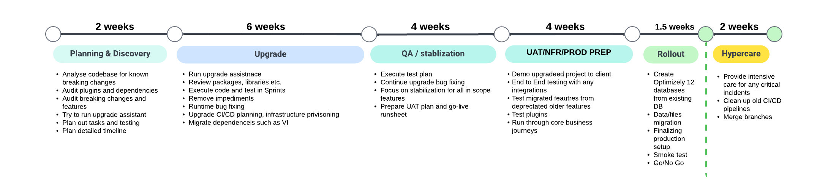
In our experience the key to a smooth delivery is a planning and discovery phase to highlight tasks. Also, the acknowledgement that these times are not fixed but an estimation and can be highly complex depending on complexity of solution
Timeline

Slide 13
Discovery & Tasks

Slide 14
You need to audit your existing solution first

Slide 15
Areas to review
Installed Packages (Optimizely, Third Party, Custom) | Customizations to the admin areas
TinyMce Configuration | Scheduled Jobs & Params
Authentication Providers | Third Party Integrations
Optimizely Integrations (Such as Visitor Intelligence + Profile Store) | Caching Strategies & Mechanisms
Image Resizing | Initialization and Configuration
Redirect Configuration | Customization to Commerce Manager
Deprecated Commerce Manager Features | Custom Editor Property Types
Visitor Group Customizations & Usage (e.g. VG technical pack) | Search Configuration + Migration
Logging Configuration | Cloudflare Setup
Change Log – Changes in the platform
Notes:
Installed Packages – Have packages been migrated to .NET 6 or is there a need to replace, consider migration of data
Customizations to the admin areas – WebForms gone, therefore admin plugins will need to be re-built
TinyMce Configuration – Differences in configuration and setup
Scheduled Jobs and Params – The jobs with params plugin no longer works, need to build an admin to manage these
Authentication Providers – Need to migrate to asp.net core identity including data migration? Need to changes to OptiID?
Third Party Integrations – Changes in ways integrations occur such as Service API
Optimizely Integrations – Visitor Intelligence removed, migration to ODP. Some integrations may not or new integrations may be useful to add during upgrade (e.g. ODP tracking)
Caching Strategies – ContentOutputCache and donut caching removed. Since .NET 8 output caching back but may need strategies for migration. Review all caching including CDN
Image Resizing – Changes in dependencies and working libraries require moving or using cloudflare resizing
Initialization and configuration – Review Init modules, web.config and startup as many changes needed to move to appsetting.json and startup.cs
Redirect Configuration – Redirects handled differently, use upgraded modules or apply on IIS redirects using middleware
Customization to Commerce Manager – Commerce manager gone, customizations need admin area or modification on CSR UI
Deprecated Commerce manager features – Areas like currencies not managed in UI, needs moving to code init
Custom Editor Property types – Editor property types using webforms will not work, needs migration as well as data migration
VG usage – What’s being used? Does it use VI? If it usages the technical criteria pack now in main project
Search and Configuration – Any complexity in configuration, migration to new cluster. Should it be replaced for Optimizely Graph?
Logging – Logging configuration, customizing logging data and sampling, changes to logging setup
Cloudflare Setup – Customizations in old DXP? Brotli compression, caching strategies, host names
Change log – Reviewing updates from CMS 12 to the new packages for big changes

Slide 16
Replacements for features that are no longer supported
Not supported in CMS 12 | Suggested replacement
Membership, Role, and Profile providers | ASP.NET Core Identity
WCF-based Lucene search index | Search & Navigation or Search 10 with MassTransit
WCF-based remote event provider | Azure Service Bus
XForms | Forms add-on
IInitializableHttpModule, HttpHandlers | ASP.NET Core middleware or endpoint route
Microsoft extension methods: Html.ActionLink, Html.BeginForm | Optimizely CMS extension methods: Html.ContentLink, Html.BeginContentForm
Admin & Reports plugins, Dashboard gadgets | Extend UI using a Menu provider
Partial controllers | View components
Optimizely Forms Captcha (uses System.Drawing) | Optimizely Forms Recaptcha
Notes:
Partial Controllers
In ASP.NET MVC, you could have a partial controller that was called as part of the execution of another controller. For example, you could use the BlockController<TBlock> and PartialContentController<TContent> classes as base controllers for such "partial" controller, but they were converted to view components in CMS 12.
In CMS 12, you should change the base class to BlockComponent<TBlock> or PartialContentComponent<TContent>, AsyncPartialContentComponent<TContent>.
View components in ASP.NET Core
https://docs.microsoft.com/en-us/aspnet/core/mvc/views/view-components

Slide 17
Convention changes in .NET 5/6/8+ and CMS 12

Slide 18
Upgrade Assistant
There is one, however it may or may not work fully for your project.
It tries to:
Create a backup
Identify solution conversion order
Run try-convert – Standard Microsoft package and is found on GitHub.
Remove transitive NuGet package dependencies
Re-target project to .NET 6
Update NuGet packages – Upgrade assistant updates NuGet packages to versions compatible with .NET 6.
Add template files
Migrate app config files
Update source code – Some light touch code changes (e.g. namespace, NOT any of the heavy lifting)
https://docs.developers.optimizely.com/content-management-system/docs/upgrade-assistant
Notes:
Migrate Authentication and Identity to ASP.NET Core
https://docs.microsoft.com/en-us/aspnet/core/migration/identity
Migrate from ASP.NET Membership authentication to ASP.NET Core 2.0 Identity
https://docs.microsoft.com/en-us/aspnet/core/migration/proper-to-2x/membership-to-core-identity
Migrating an Existing Website from SQL Membership to ASP.NET Identity
https://docs.microsoft.com/en-us/aspnet/identity/overview/migrations/migrating-an-existing-website-from-sql-membership-to-aspnet-identity

Slide 19
Solution Configuration
No more web.config
Everything in appsettings.json, with many breaking changes in namings
Upgrade assistant may have done some of it for you
JSON namings are case sensitive!
https://docs.developers.optimizely.com/content-management-system/docs/configuring-cms
Notes:
Migrate Authentication and Identity to ASP.NET Core
https://docs.microsoft.com/en-us/aspnet/core/migration/identity
Migrate from ASP.NET Membership authentication to ASP.NET Core 2.0 Identity
https://docs.microsoft.com/en-us/aspnet/core/migration/proper-to-2x/membership-to-core-identity
Migrating an Existing Website from SQL Membership to ASP.NET Identity
https://docs.microsoft.com/en-us/aspnet/identity/overview/migrations/migrating-an-existing-website-from-sql-membership-to-aspnet-identity

Slide 20
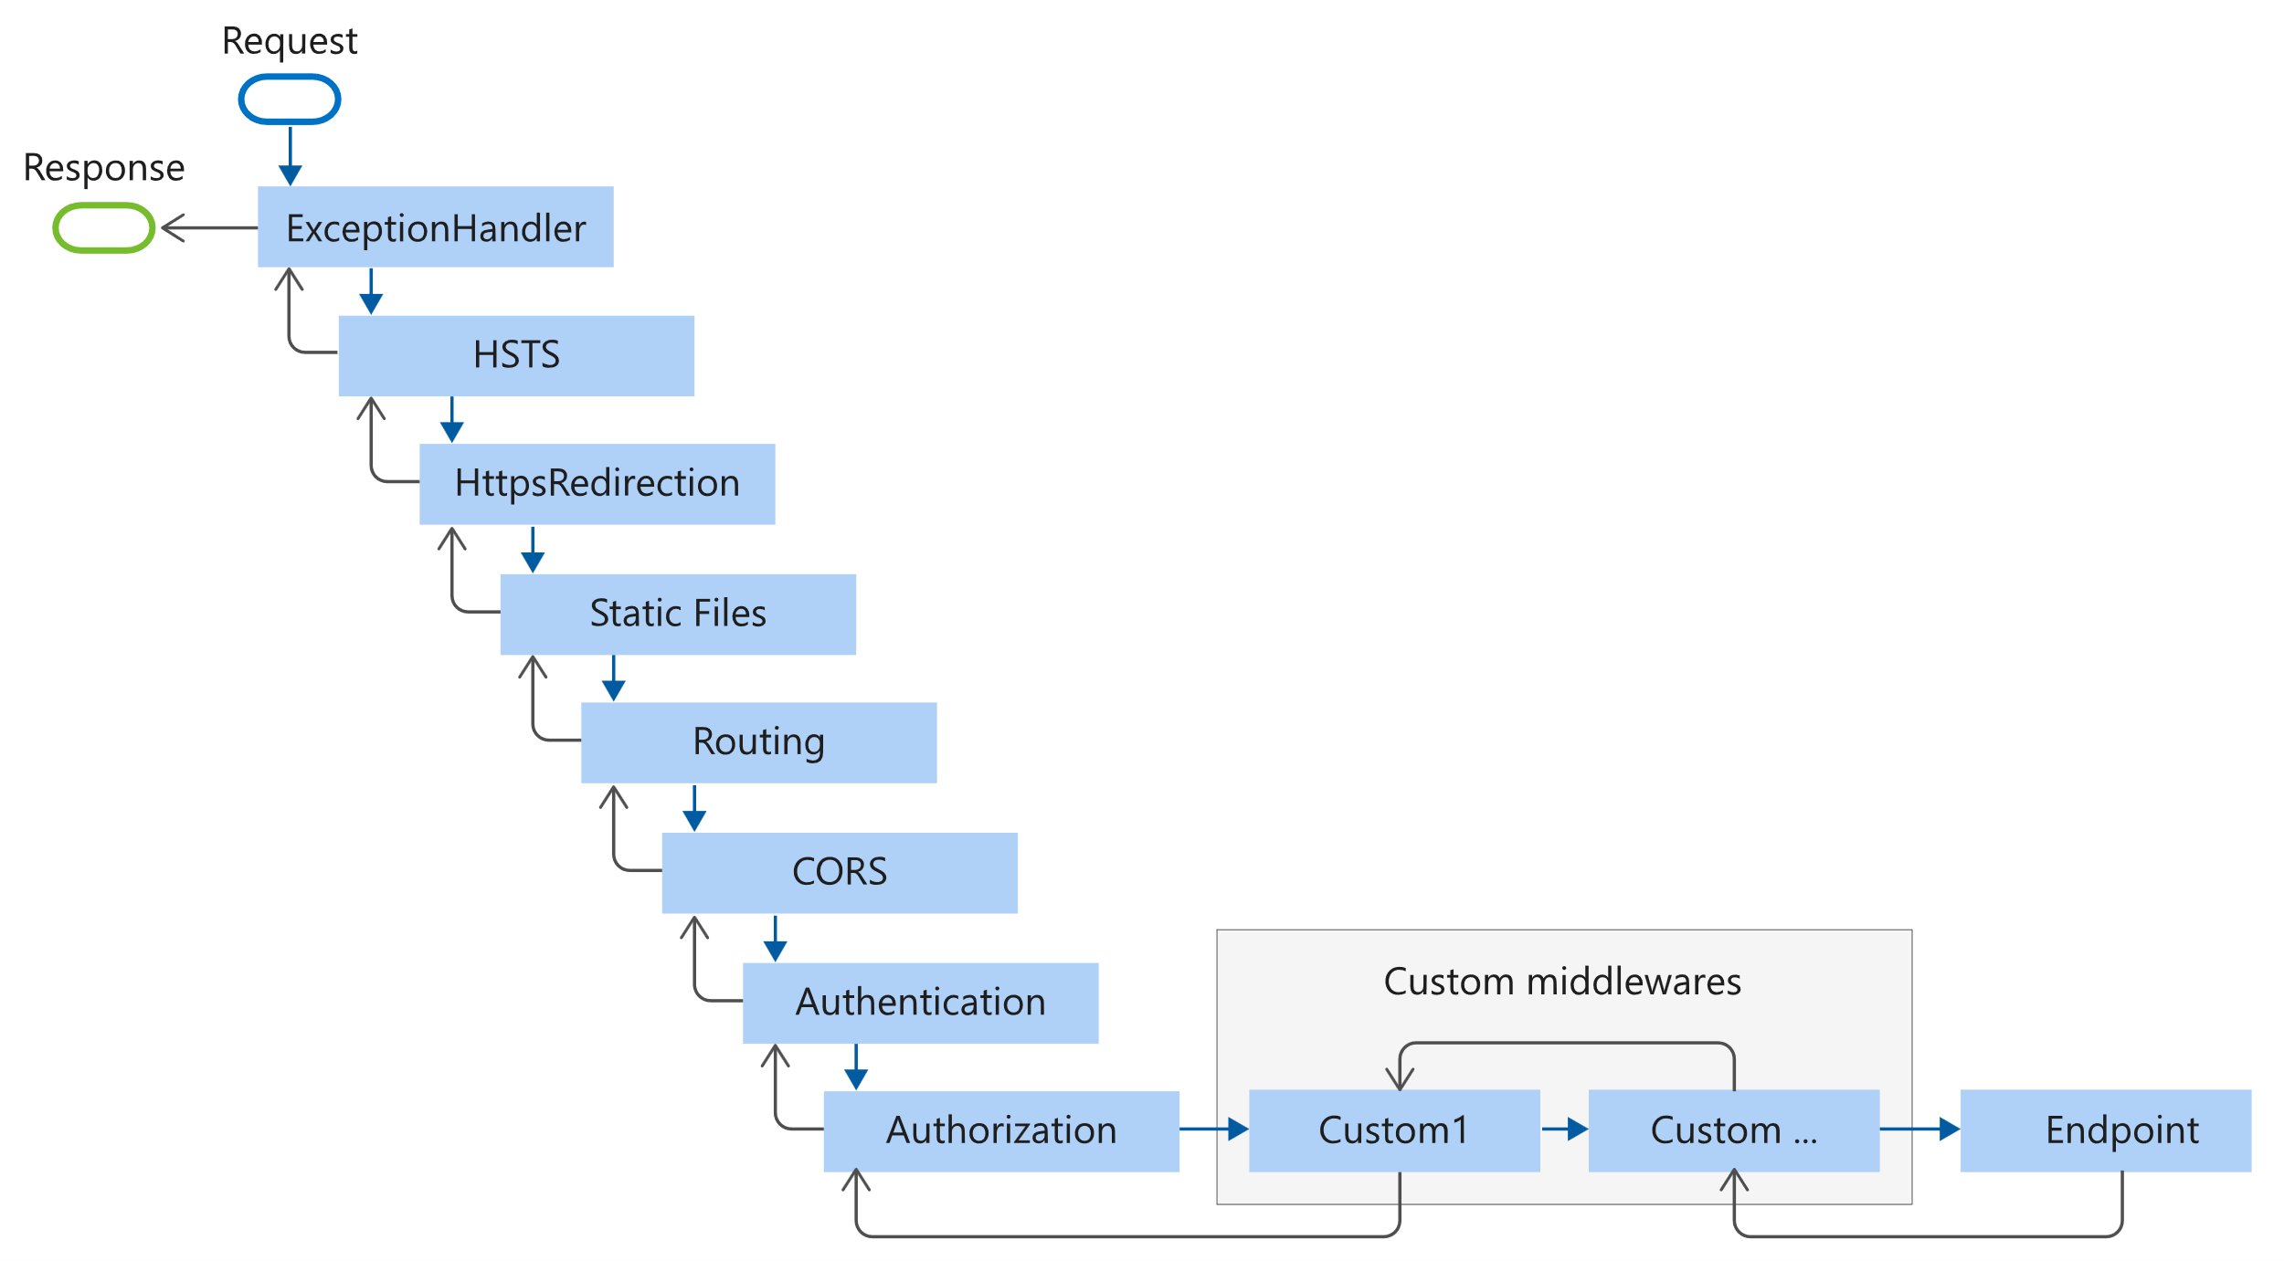
Solution Startup
Relies heavily on the "middleware
pipeline" approach where
everything is a middleware you
have to enable if you use it in
your Startup.cs
The order of the items
is super important
https://learn.microsoft.com/en-us/aspnet/core/fundamentals/middleware/?view=aspnetcore-6.0#middleware-order-1
Notes:
Migrate Authentication and Identity to ASP.NET Core
https://docs.microsoft.com/en-us/aspnet/core/migration/identity
Migrate from ASP.NET Membership authentication to ASP.NET Core 2.0 Identity
https://docs.microsoft.com/en-us/aspnet/core/migration/proper-to-2x/membership-to-core-identity
Migrating an Existing Website from SQL Membership to ASP.NET Identity
https://docs.microsoft.com/en-us/aspnet/identity/overview/migrations/migrating-an-existing-website-from-sql-membership-to-aspnet-identity

Slide 21
Site Root
Assets are now served from the default wwwroot folder, rather than the project root
You can change it if you want, but beware there's less guard-rails than IIS had (e.g. you can end up exposing your appsettings.json file via http – not good!)
You can have multiple asset folders mapped for different URL segments
Notes:
Migrate Authentication and Identity to ASP.NET Core
https://docs.microsoft.com/en-us/aspnet/core/migration/identity
Migrate from ASP.NET Membership authentication to ASP.NET Core 2.0 Identity
https://docs.microsoft.com/en-us/aspnet/core/migration/proper-to-2x/membership-to-core-identity
Migrating an Existing Website from SQL Membership to ASP.NET Identity
https://docs.microsoft.com/en-us/aspnet/identity/overview/migrations/migrating-an-existing-website-from-sql-membership-to-aspnet-identity

Slide 22
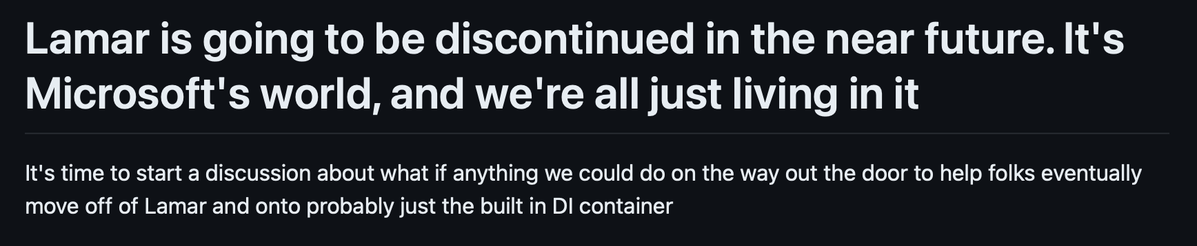
Dependency Injection - The MS Way
No more StructureMap. The StructureMap team recommended "Lamar", but even that is being sunset
Likely best to rewrite your custom DI to use the standard Microsoft way to help make future upgrades easier
Some things are much more difficult and/or impossible. E.g. assembly scanning (you could with something like Scrutor); Named Instances - you will have to roll your own approach or find a package you trust enough to exist long term
Notes:
Migrate Authentication and Identity to ASP.NET Core
https://docs.microsoft.com/en-us/aspnet/core/migration/identity
Migrate from ASP.NET Membership authentication to ASP.NET Core 2.0 Identity
https://docs.microsoft.com/en-us/aspnet/core/migration/proper-to-2x/membership-to-core-identity
Migrating an Existing Website from SQL Membership to ASP.NET Identity
https://docs.microsoft.com/en-us/aspnet/identity/overview/migrations/migrating-an-existing-website-from-sql-membership-to-aspnet-identity

Slide 23
Authentication Providers
Not too much has changed here if you use one of the usual providers, good documentation should be available. Asp.net core will however need your passwords migrated (see next slide)
If you use multiple authentication providers, e.g. one for CMS access and another for user login, the magic search term you need is "mixed-mode authentication".
Mixed-mode authentication can be done on specific URLs (.e.g /episerver), or by decorating controller actions with an action filter
Some community plugins may need to be pointed to the correct auth scheme, e.g. "/GetaNotFoundHandlerAdmin"
[Authorize(AuthenticationSchemes = "ExampleSchemeAzureB2C", Roles = "CustomerUsers")]
https://docs.developers.optimizely.com/content-management-system/docs/mixed-mode-authentication
Notes:
Migrate Authentication and Identity to ASP.NET Core
https://docs.microsoft.com/en-us/aspnet/core/migration/identity
Migrate from ASP.NET Membership authentication to ASP.NET Core 2.0 Identity
https://docs.microsoft.com/en-us/aspnet/core/migration/proper-to-2x/membership-to-core-identity
Migrating an Existing Website from SQL Membership to ASP.NET Identity
https://docs.microsoft.com/en-us/aspnet/identity/overview/migrations/migrating-an-existing-website-from-sql-membership-to-aspnet-identity

Slide 24
Authentication, authorization, and user profiles
Membership, Role and Profile providers are not supported in ASP.NET Core. You should migrate to an alternative like ASP.NET Core Identity.
In CMS 11, you can restrict access to virtual paths by defining an authorization element in web.config for a specific path and there define which users or roles can access that path.
Sven-Erik Jonsson: https://www.getadigital.com/blog/upgrading-to-optimizely-12-asp.net-core-identity
In ASP.NET Core, Web.config is gone so you cannot restrict access to virtual paths in the same way.
In CMS 12, shell modules are registered with a policy that specifies who can access resources from the module. A shell module's manifest defines which policy applies to a module. If you specify no policy, then CmsPolicyNames.DefaultShellModule is registered by default. You can configure the members of the default policies using CmsPolicyOptions.
<location path="EPiServer"> <system.web> <authorization>
<allow roles="WebEditors, WebAdmins, Administrators" />
<deny users="*" />
Notes:
Migrate Authentication and Identity to ASP.NET Core
https://docs.microsoft.com/en-us/aspnet/core/migration/identity
Migrate from ASP.NET Membership authentication to ASP.NET Core 2.0 Identity
https://docs.microsoft.com/en-us/aspnet/core/migration/proper-to-2x/membership-to-core-identity
Migrating an Existing Website from SQL Membership to ASP.NET Identity
https://docs.microsoft.com/en-us/aspnet/identity/overview/migrations/migrating-an-existing-website-from-sql-membership-to-aspnet-identity

Slide 25
Image Resizing - New Option
Roll your own, probably using ImageSharp (included as transitive dependency with CMS 12 anyway)
Community plugin available to make integration easy
Use Cloudflare edge image resizing (DXP Only)
🚨 It is still in "Beta" so things may break - https://www.optimizely.com/sv/campaigns/marketing-pages/beta/beta-signup/
Community plugin available to make integration easy
https://tedgustaf.com/blog/2023/cloudflare-image-resizing-and-cropping-in-optimizely-dxp/
https://world.optimizely.com/blogs/Minesh-Shah/Dates/2023/10/responsive-image-rendering-at-the-edge/

Slide 26
DXP Go live 🚀

Slide 27
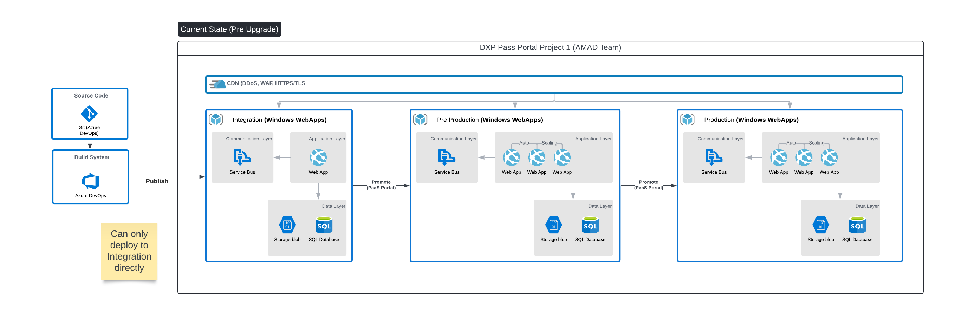
CMS 11 / Commerce 13 DXP

Slide 28
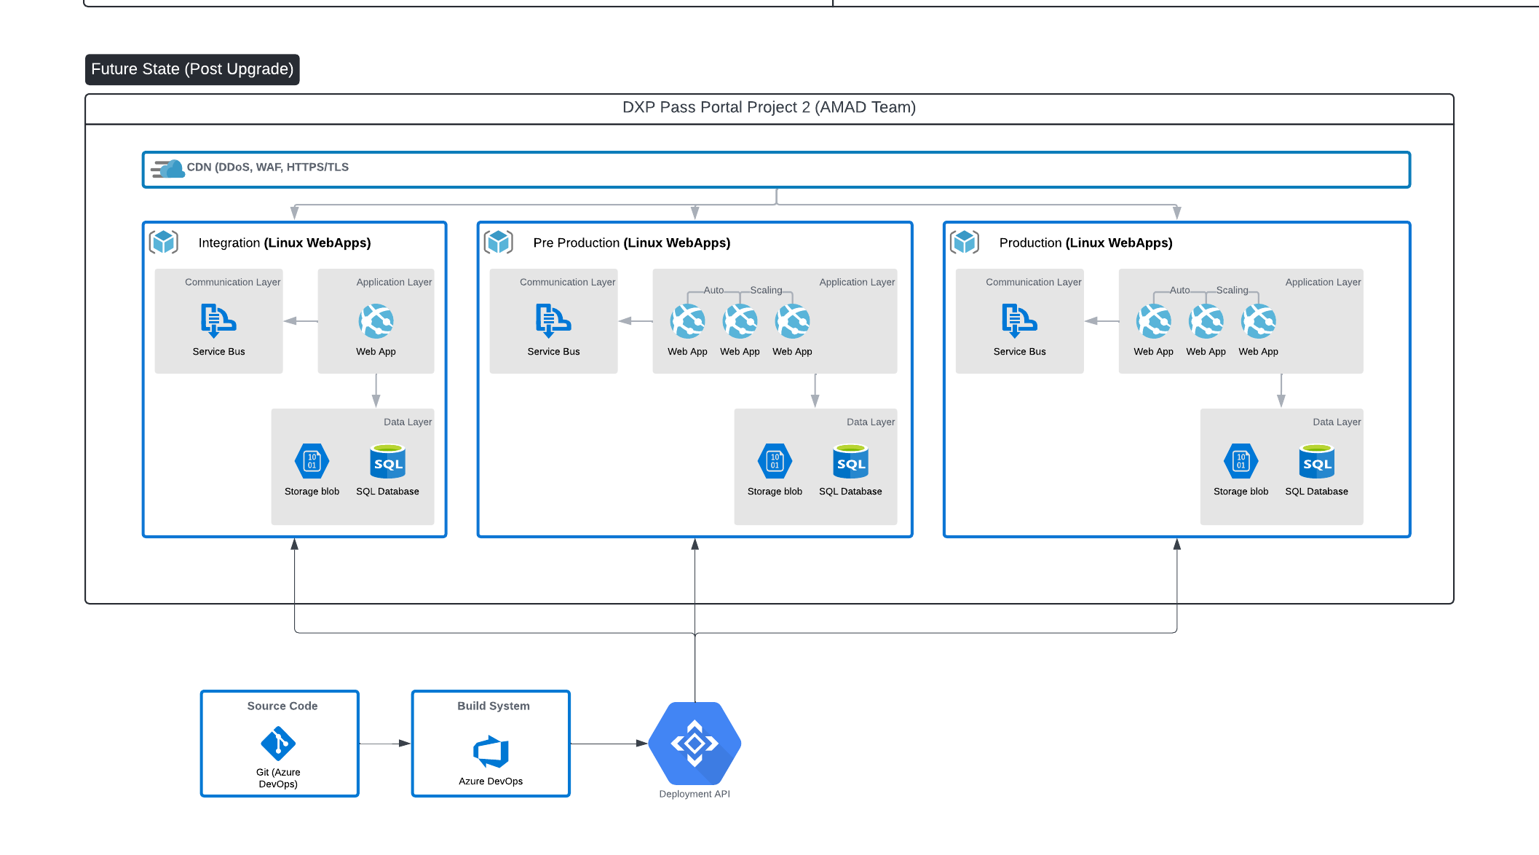
CMS 12 / Commerce 14 DXP

Slide 29
Optimizely DXP environments for modern .NET platforms
Optimizely DXP cloud hosting for CMS 12 and Commerce 14
CMS 11 and Commerce 13 use Windows Server-based environments with .NET Framework 4.8.
CMS 12 and Commerce 14 use Linux-based containerized environments with .NET 5 or later.
You can develop modern solutions on Windows, but you might want to test deploying to Linux-based containers to ensure the best outcomes when deploying to DXP environments.
DXP environment
.NET Framework 4.8
Windows Server + IIS
DXP environment
.NET 5 or later
Linux Server + Kestrel
CMS 11, Commerce 13
CMS 12, Commerce 14
Container
Warning! The use of a container makes deployment failures harder to fix because support has no visibility inside it.

Slide 30
Deployment steps
Optimizely DXP cloud hosting for CMS 12 and Commerce 14
Add a wildcard * binding to the hostnames for the site in the Manage Websites screen.
Add the EPiServer.CloudPlatform.(Cms/Commerce) package(s) to the website.
Call AddCmsCloudPlatformSupport + AddCommerceCloudPlatformSupport if not development.
Publish the website to a local folder, zip the contents of the publish directory, and rename the file to ProjectName.cms.app.1.0.0.nukpg to create a code package.
Deploy the package using Deployment API:
https://docs.developers.optimizely.com/digital-experience-platform/v1.2.0-dxp-cloud-services/docs/creating-a-new-cms-site-and-deploying
Connect-EpiCloud -ProjectId "projectId" -ClientKey "key" -ClientSecret "secret"
$sasUrl = Get-EpiDeploymentPackageLocation
Add-EpiDeploymentPackage -SasUrl $sasUrl -Path .\AlloyNet5.cms.app.1.0.0.nupkg
Start-EpiDeployment -DeploymentPackage "AlloyNet5.cms.app.1.0.0.nupkg"
-TargetEnvironment "Integration" -DirectDeploy -Wait
Notes:
Call out to make sure to use "Install-Module -Name Azure.Storage -Scope CurrentUser -Repository PSGallery -Force –AllowClobber" rather than that documented on the DXP Deployment page

Slide 31
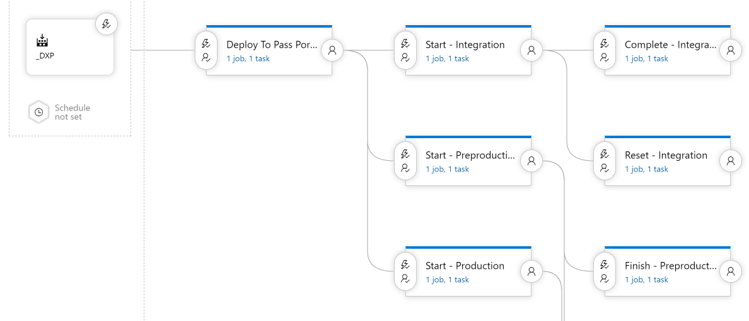
Deployment Using Azure DevOps and Powershell
Optimizely DXP cloud hosting for CMS 12 and Commerce 14
Use Azure pipeline to create an output package
  Restore and publish .NET 5 solution
  Build front end framework (Node, Gulp, Webpack)
  Create zip package and publish artifact (cms.app.1.0.0.nukpg) using SemVer or incrementing
Use Release to deploy published artifact
  Push package to Portal
  Start deployment of target environment
  Check slot
  Finish or Reset deployment

Slide 32
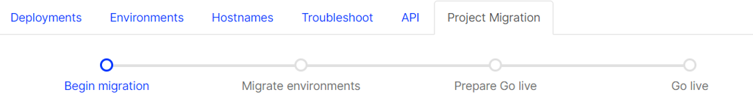
Migrating to our modern platforms on DXP
Optimizely DXP cloud hosting for CMS 12 and Commerce 14
After using the Upgrade Assistant to migrate your code base, you will then need to migrate your DXP environments. We enable you to deploy sites in parallel to existing environments.
This allows you to start deploying your new Content Cloud 12 and Commerce Cloud 14 solutions without affecting status quo.
You can copy content to the new environments.

Slide 33
Tips on Load Testing & Going Live
Optimizely DXP cloud hosting for CMS 12 and Commerce 14
New Linux Environments are created with lower tier. Make sure to load test and scale out to meet expected demand
Configure telemetry and logging for .NET 6
New project has different SendGrid credentials, make sure any SPF and mail records are on new configuration
Carefully plat process for swapping integrations, jobs over so that any connected integration such as ERPs you don’t lose data
Test the migration steps and work out a timeline for restoring, re-configuring and testing
VALIDATION in any tools (Lighthouse, Screaming Frog, SiteImprove)
Monitor closely after going live
https://world.optimizely.com/blogs/arjanblog/dates/2023/7/finetuning-application-insights-in-cms12/

Slide 34
Q&A
Forums:
https://world.optimizely.com/forum/
Slack channel:
https://optimizely-community.slack.com/

Slide 35
Optimizely Content Management Platform 12

